Slide 1


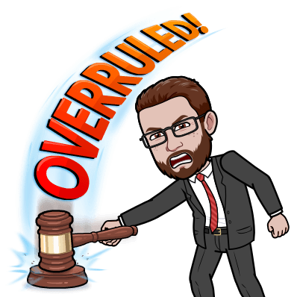
Mock Trials

Slide 2
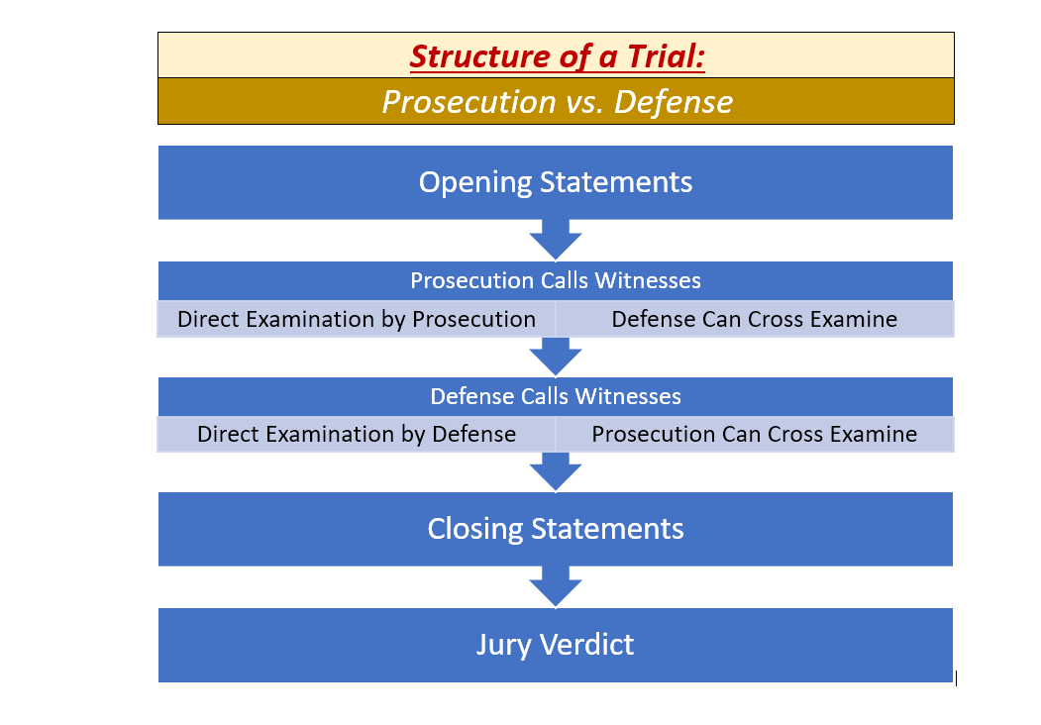
Structure of a Trial

Slide 3
Case 1: STATE v. TONY
Question: Did Tony throw the stone that broke Mr. Wiley’s windows?
Crime: Vandalism
Whoever intentionally causes damage to physical property of another without his or her consent is guilty of misdemeanor and will be sentenced to imprisonment for not more than 90 days or payment of a fine of not more than $1,000 or both.

Slide 4
Case 1: STATE v. TONY
VERDICT:
We, the jury, find the defendant, Tony…
NOT GUILTY!!!!
… by a vote of 8-4. Remember, in a real trial, the verdict would need to be unanimous (all would have to agree).

Slide 5
Case 3: STATE v. MAX PAULSON
Question: Did Max drive recklessly when he collided with bicyclist Sam Smith?
Crime: Reckless Driving
Any person who drives any vehicle in such a manner as to indicate a willful or a wanton disregard for the safety of persons or property OR a disregard of the rights of others in a manner that is likely to endanger any person or any property is guilty of the misdemeanor of reckless driving.

Slide 6
Case 3: STATE v. MAX PAULSON
Prosecution:
Lawyer: Willie
Officer Rudy: Trenton
Sam (Victim): Ryan
Eric (Witness): Glenia
Researcher: Christian
Defense:
Lawyer: Arianna
Max (Defendant): Luciano
Sara (Witness): Daniella
Cynthia (Expert): Natalie
Researcher: Amanda

Slide 8
Case 3: STATE v. MAX PAULSON
Question: Did Max drive recklessly when he collided with bicyclist Sam Smith?
Crime: Reckless Driving
Any person who drives any vehicle in such a manner as to indicate a willful or a wanton disregard for the safety of persons or property OR a disregard of the rights of others in a manner that is likely to endanger any person or any property is guilty of the misdemeanor of reckless driving.

Slide 9
Case 2: STATE v. ANDERSON
Question: Did the defendant move over the required lanes when passing an emergency vehicle?
Crime: Failing to move “a lane away”
When approaching and before passing an emergency vehicle that is parked or stopped on or next to a street having two or more lanes in the same direction, the driver of a vehicle shall safely move the vehicle to a lane away from the emergency vehicle.

Slide 10
Case 2: STATE v. ANDERSON
Prosecution:
Lawyer: Gabriella
Officer Yang:
Al Schriver (Witness):
Researcher:
Defense:
Lawyer(s): Gael & Isaiah
Matthew Anderson (Defendant): Armani
Aiden (Witness): Brian

Slide 11
Case 2: STATE v. ANDERSON
Question: Did the defendant move over the required lanes when passing an emergency vehicle?
Crime: Failing to move “a lane away”
When approaching and before passing an emergency vehicle that is parked or stopped on or next to a street having two or more lanes in the same direction, the driver of a vehicle shall safely move the vehicle to a lane away from the emergency vehicle.

Slide 12
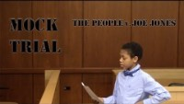
The People v. Joe Jones

Slide 13
In the meeting chat…
1) Do you think that the defendant, Joe Jones, was innocent or guilty? Why?
2) What stood out to you about this mock trial, in either a positive or negative way?
3) After watching this sample mock trial video, what is something that you think you could apply to your mock trial cases in the future?

